Slide 1
Diving Deep into Chrome’s Dev Tool
By- @SwagatSwain_

Slide 2

Web

Slide 3
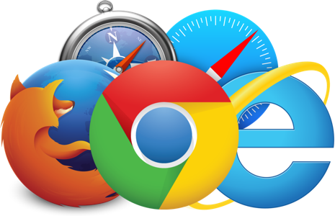
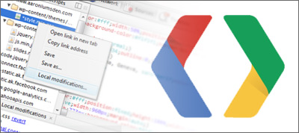
Browser & DevTools

Slide 4
Chrome’s Console
Hello World
Query Selector
Current Selector
inspect()
document.body.contentEditable
getEventListners()
monitorEventListners()
unmonitorEventListners()
console.table(var)
console.count()
console.time('myTime')
$_

Slide 5
Add-ons
Break On Exception
Visual Events
Live Reload
WorkSpace

Slide 6
Any Questions?
Thank You

